Slide 1
POVERTY AND POLLUTION IN TENNESSEE
Robert Parker//da09

Slide 2
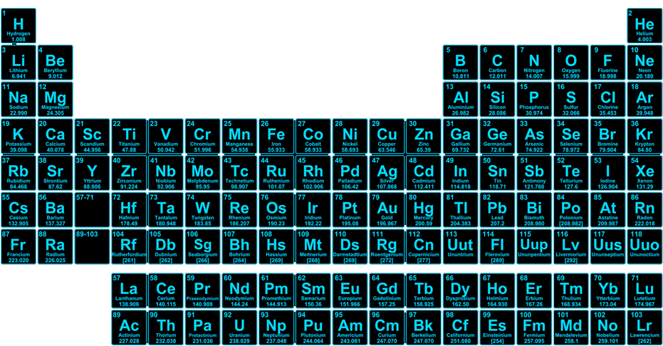
Notes:
So, for most of recorded history, humans have been surrounding themselves with a potent neurotoxin known as…

Slide 3
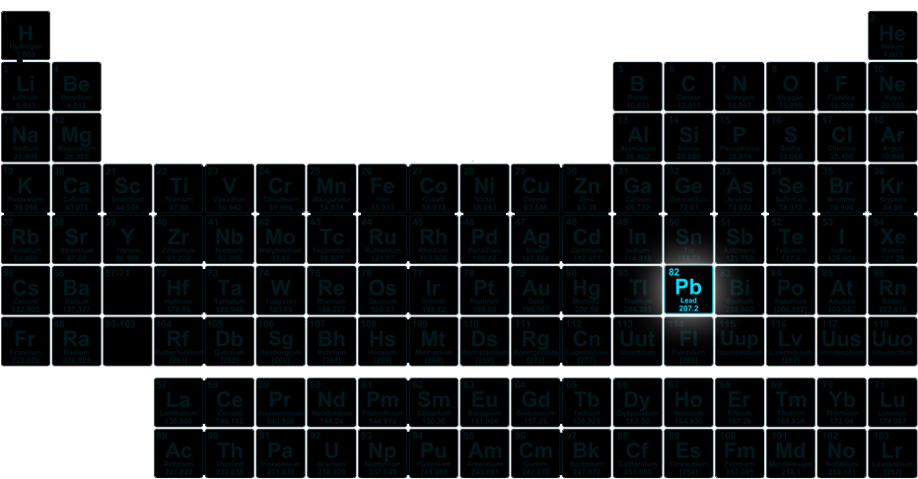
Notes:
Lead! Now, lead has a lot of great properties that made it a hot choice for metal workers and craftspeople for tens of thousands of years. It’s abundant in nature, it’s soft, malleable, very slow to rust, it has a low melting point, but maybe most importantly: it’s easy to extract.

Slide 4
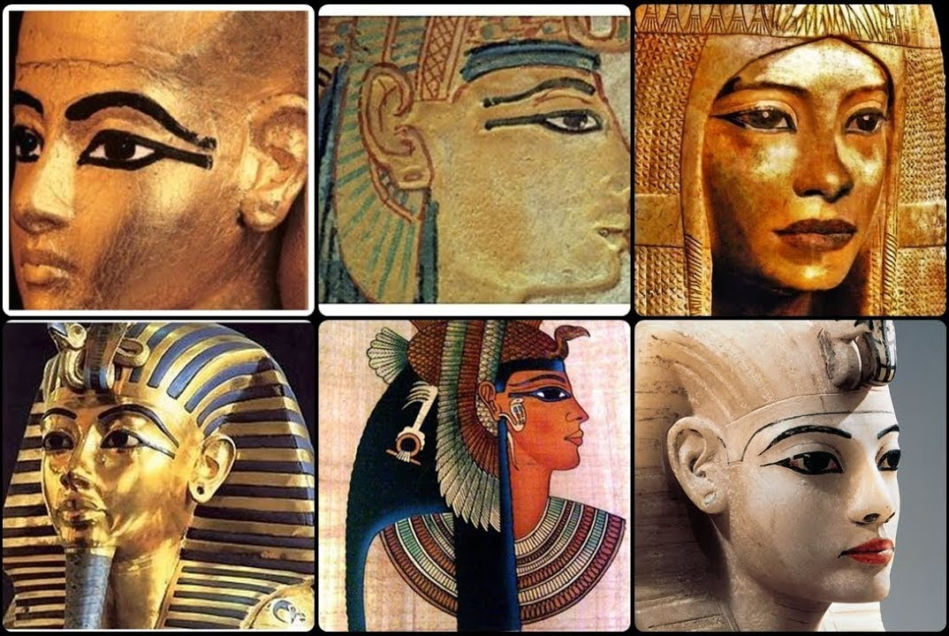
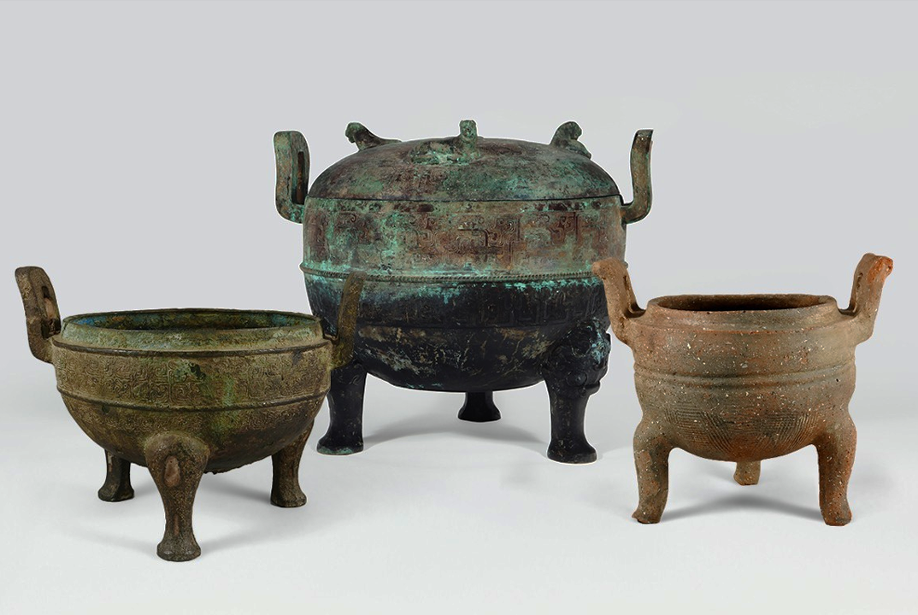
THE HISTORY OF LEAD
Ancient Egypt
Ancient China
The ancient, smokey eye makeup known as “Kohl” is made from lead ores
These ritual cauldrons were made from an alloy containing copper, tin, and lead
Notes:
And we really have been at it for tens of thousands of years. That classic smokey eye look we see in ancient Egyptian art is called “Kohl,” and it was made by grinding up chunks of lead sulfide. Imagine putting that much lead so close to your eye, right? Kohl makeup is still really popular in the middle east, but modern kohl is made from much safer materials.
And here on the right, we have a couple of ritual drinking cauldrons from the Ding dynasty, which was around the 10th and 11th century BC. And these were made from a bronze alloy that was comprised of copper, tin, and lead. Royals would drink this highly acidic wine that would leech incredible amounts of lead into the rest of the cauldron.

Slide 5
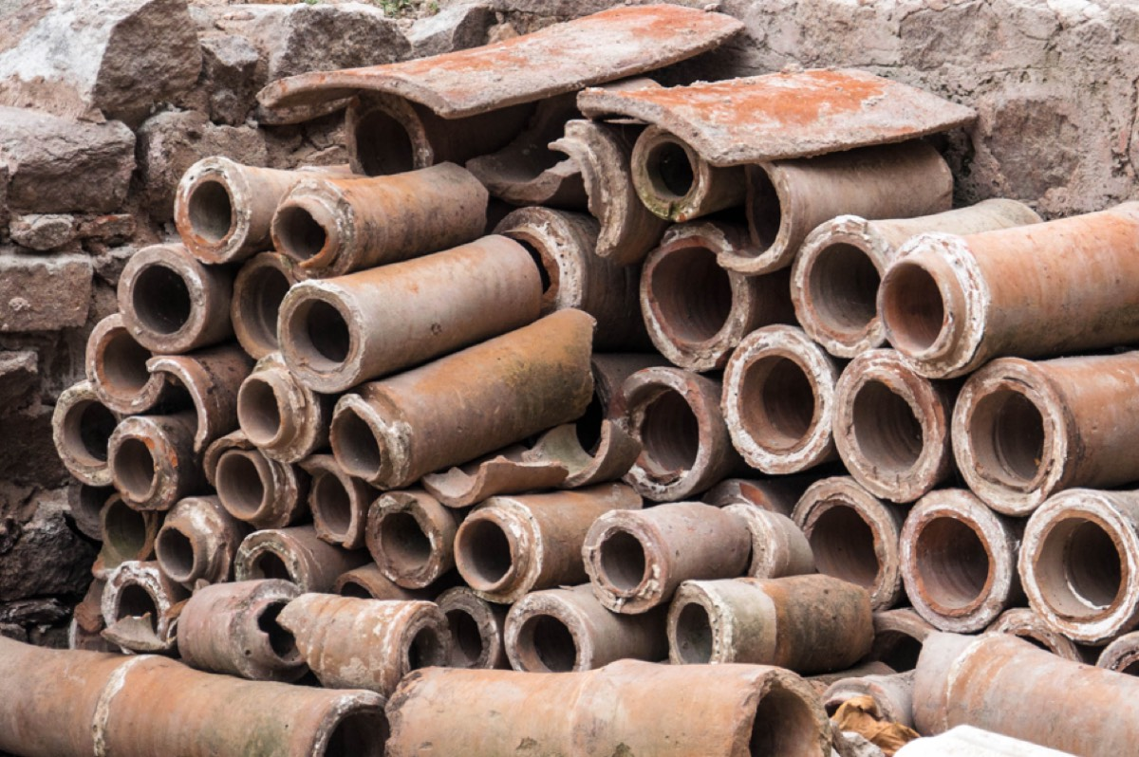
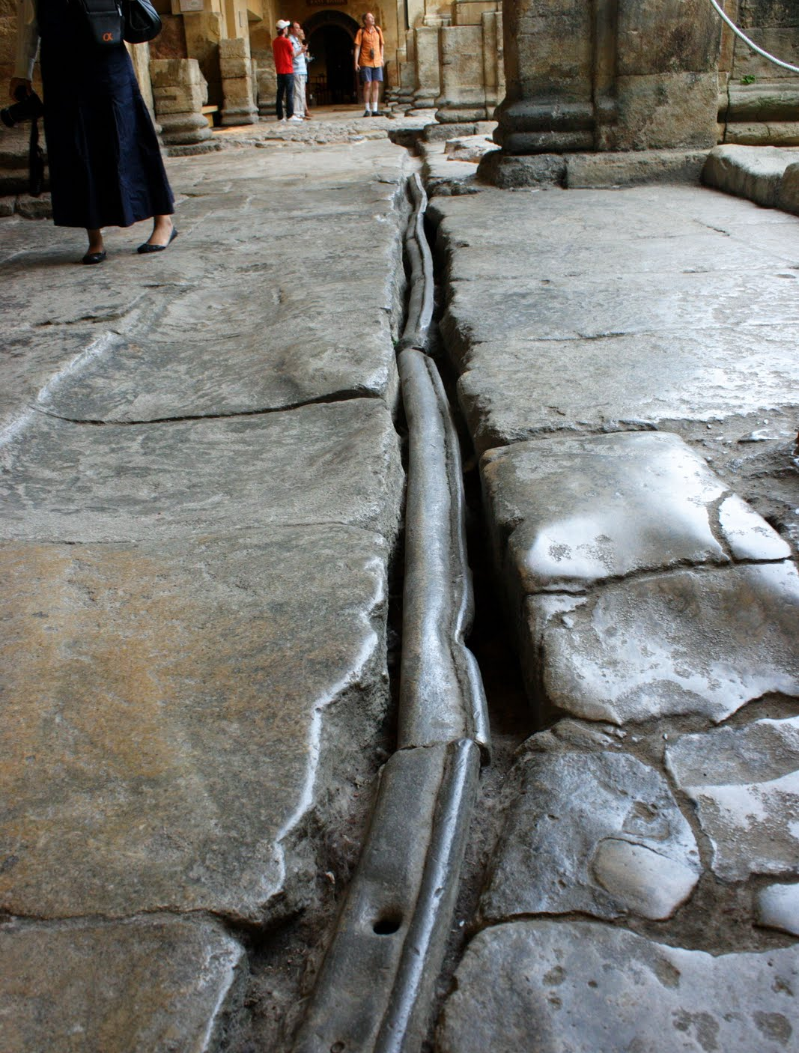
ANCIENT ROME
At its peak, the Roman civilization was producing 60,000 to 80,000 tons of lead per year
Notes:
And of course, we all know about the lead piping used by the ancient Romans. Folks like to say that this contributed to the downfall of the whole empire, and it probably did. But what was worse perhaps is the fact that their eating utensils and drinking vessels were also made from lead.

Slide 6
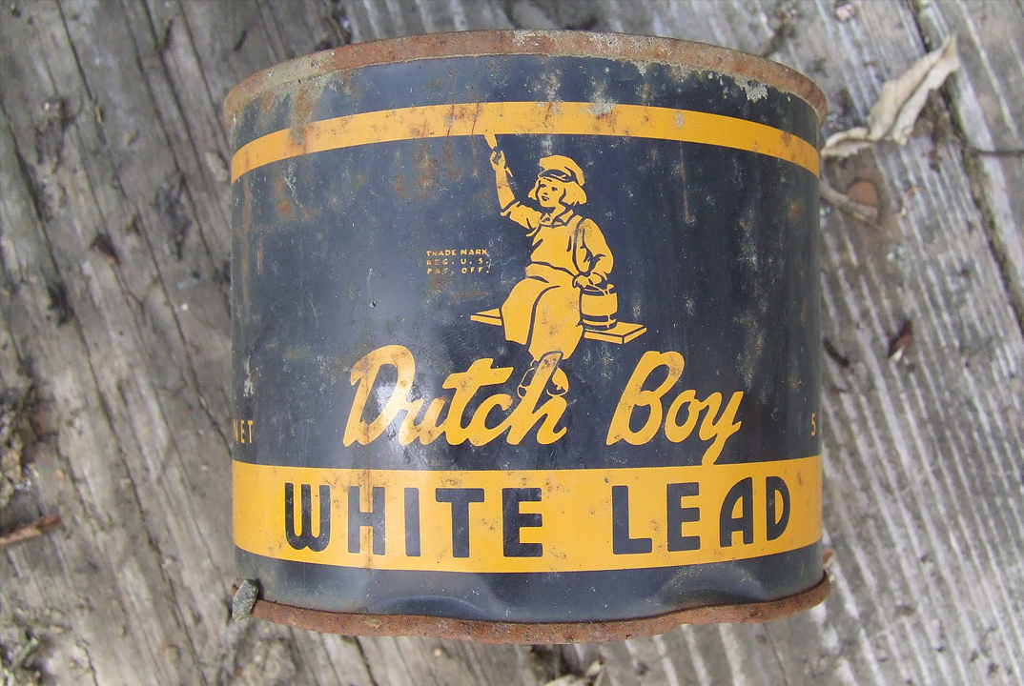
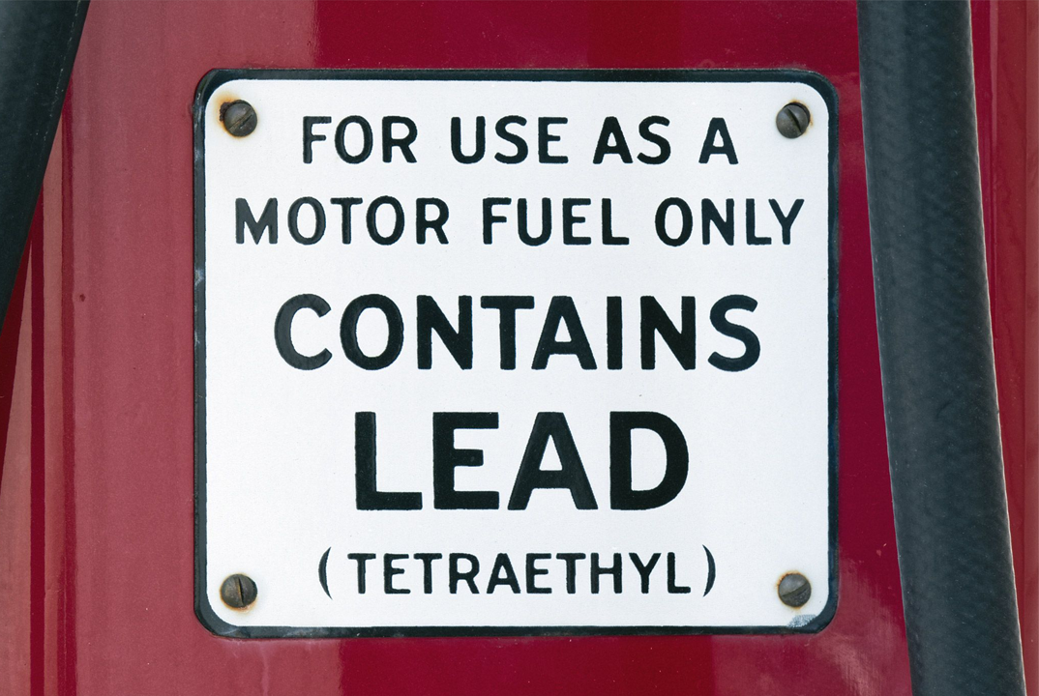

MODERN SOURCES OF LEAD
Lead Paint
Leaded Gasoline
Lead additives accelerate drying and increases durability
Tetraethyllead boosts octane rating and improves performance and fuel economy
Notes:
So we’re all aware of these two most common sources of ambient lead in our immediate environments. Lead has been added to paint since the 4th century BC partially because it helps speed up drying and improves durability, but largely because until the 20th century it was the only truly white pigment available in enough quantities to be actually useful.
Up until it was banned in 1978, lead paint was used extensively in home construction. If anyone here is a homeowner, you know that before you can close on one of these older homes you have to sign a disclosure that basically says, “Hey, this house might have lead paint. Hope that’s cool!”
So, leaded gasoline is particularly bad. Ever since the 1920s, lead was added to gasoline because it greatly improves performance and fuel economy. The problem is that its molecular makeup allows it to dissolve quicker in oils and fats, which lets it easily cross the blood-brain barrier. So imagine millions of vehicles pumping out this aerosolized, extra deadly form of lead all day, every single day.
The use of catalytic converters wasn’t required by law until 1975 and the outright sale of leaded gasoline wasn’t banned until 1996. It’s still used to this day in aircraft fuel, but for the vast majority of the developed world, it’s been totally phased out.
Now, there are some less well-known modern sources of lead that might surprise you.

Slide 7




MODERN SOURCES OF LEAD
Cosmetics
Candy
99% of externally applied cosmetics contain up to 10ppm of lead
Lead acetate was used as a sweetener, and ink used in candy wrappers can contain lead
Notes:
So, lead had been added to cosmetics for centuries because like I mentioned earlier it was the only real source of white pigment. As you can see here there’s still tiny amounts present in, but remember it accumulates in your body. And there’s no so safe level of lead that isn’t toxic to some extent. It serves no known biological purpose.
Lead acetate, or lead sugar as it was called back in the day, was pretty common in candy and some spices up until the turn of the century. But even today, candy that’s been imported from other parts of the world have the danger of being contaminated with lead during the production process, and to this day small amounts of lead present in the ink used on the wrappers has the chance to leech into the candy.

Slide 8
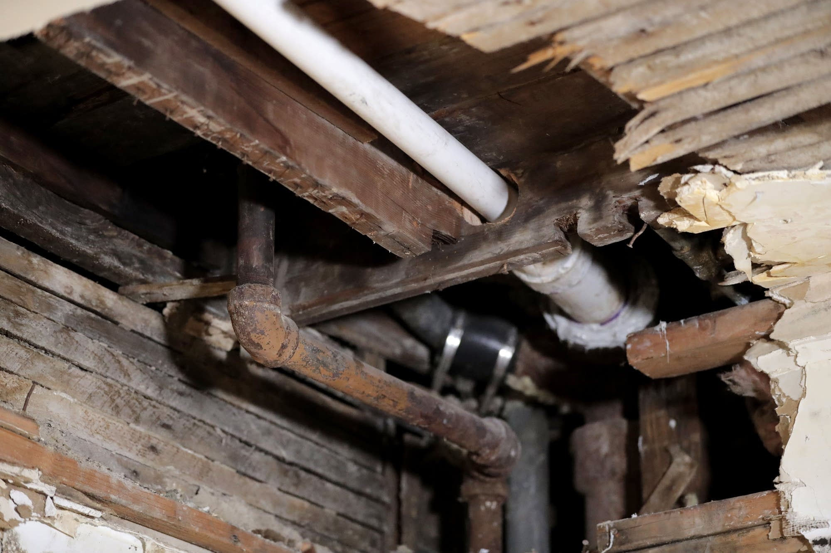
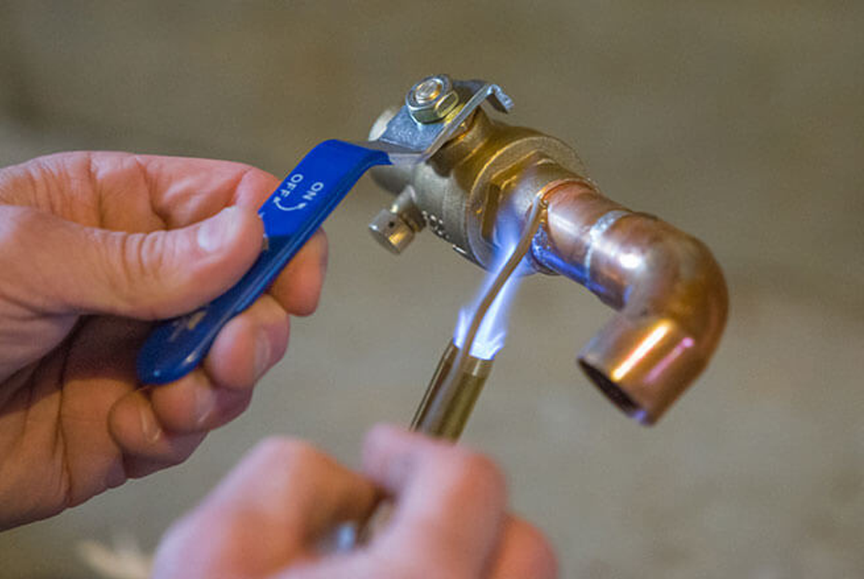


MODERN SOURCES OF LEAD
Lead Pipes
Lead Solder
The EPA estimates that 9.2 million lead water pipes are still in use
Joining copper pipes with lead solder was the industry standard until 1986
Notes:
Now, we’re all aware of the dangers of using lead water pipes. This is kind of nightmare to deal with at the municipal level because the lead gets added to your water long after it leaves any kind of treatment facility.
But even if you have copper piping, you’re not totally out of the woods yet. Until it was banned in 1986, lead solder was the industry standard for joining copper pipes. And any high temperate water that flows past those joints has the potential to add lead.

Slide 9
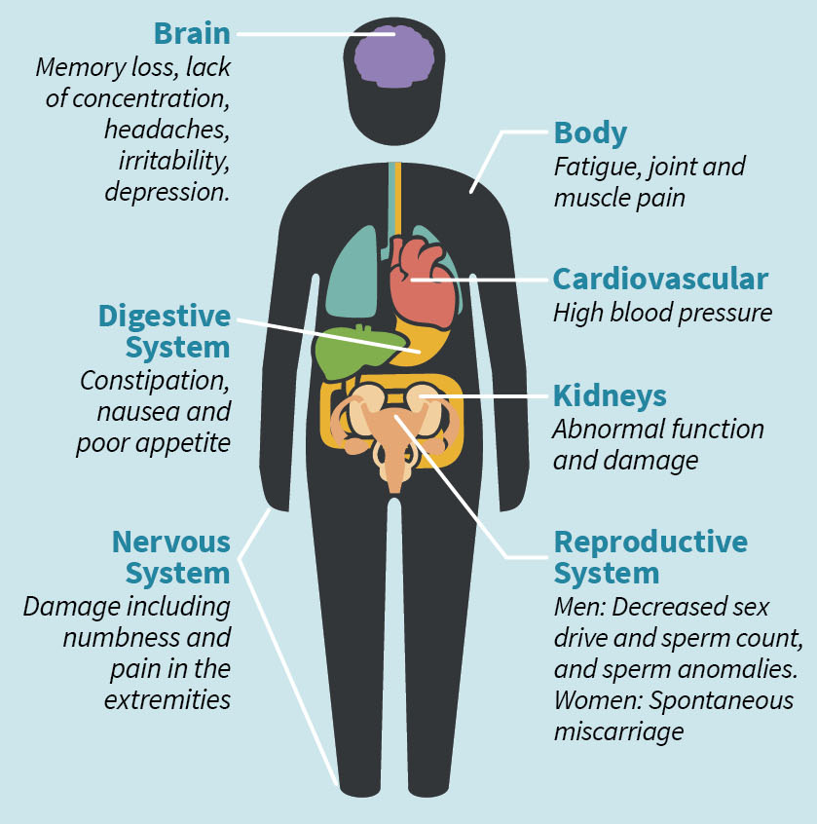
Memory Loss
Lack of Concentration
Irritability
Depression
Notes:
Now, what are the actual effects of lead poisoning? Well, I’ve highlighted some of the mental effects on adults here: memory loss, lack of concentration, irritability, depression, but it wreaks havoc on the entire body. High blood pressure, kidney damage, increased chance of miscarriage…no part of the body is spared. But the effects are worse on children.

Slide 10
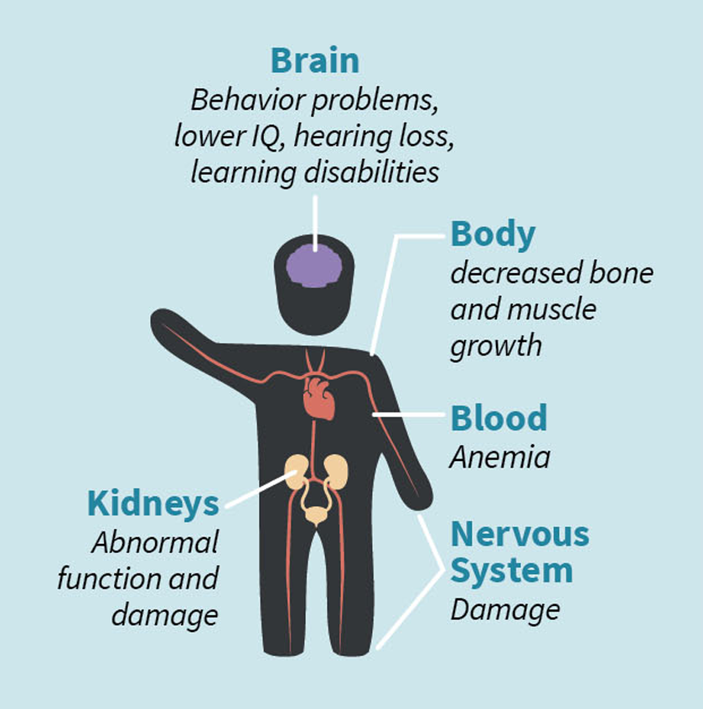
Behavior Problems
Lower IQ
Cognitive Dysfunction
Hearing Loss
Notes:
Most notably on their nervous systems. We’ve observed behavior problems, lower IQ’s, cognitive dysfunction, even hearing loss…and a lot of these symptoms aren’t truly evident until they reach adolescence or adulthood. So by the time a parent can be made aware of the danger, it’s already too late. These kids are damaged permanently.
So it’s critically important that we remove or eliminate lead from as many communities as possible so we’re not starting another generation off with a handicap. And at the federal level we’ve made a lot of progress in the past 50 years.
So how are we doing here in Tennessee? Good? Bad? And if we’re doing badly, what’s the human cost? Let’s take a look.

Slide 11
Elevated Blood Lead Levels (EBLL)
Blood lead concentrations above 5_{μg/dL} (micrograms per deciliter) are considered elevated
Notes:
One way we can figure this out is by measuring what’s called EBLL, or Elevated Blood Lead Levels.
Every year, the Tennessee Department of Health tests the lead levels in a selection of children in all 95 counties, and when they get a result higher than 5 micrograms of lead per deciliter of blood, it’s logged internally and reported to the Centers for Disease Control.
That’s 5 millionths of a gram per one tenth of a liter, which is about three and half ounces. That’s how little lead it takes to permanently alter a child. And that threshold was actually reduced to 3.5 millionths back in October of last year.

Slide 12
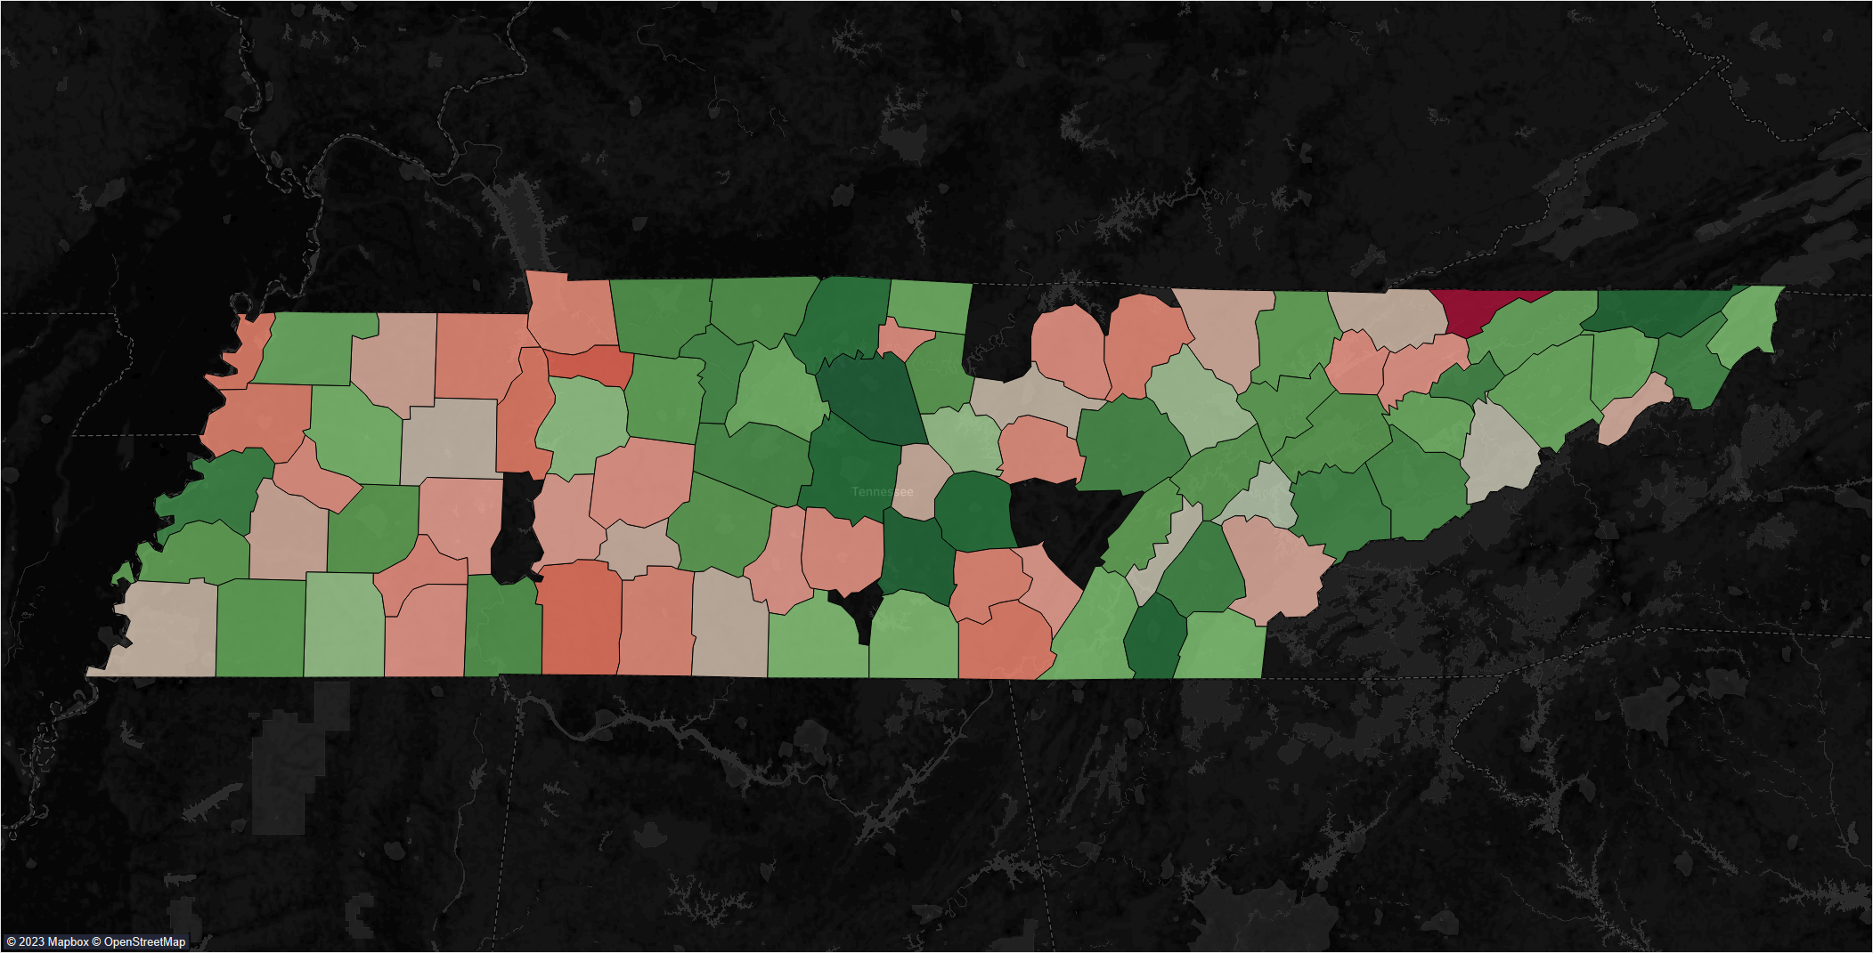
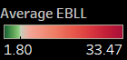
Notes:
So for this map I took the average EBLL per 1,000 children from the past 5 years of publicly available data and then assigned it to the appropriate county.
A few counties had their data suppressed because there were fewer than 50 children living there, so at the end of the day we’re looking at 88 out of 95 counties.
And color-wise, we’re looking at green being fewer children per capita with an elevated blood lead level and closer to red representing a higher EBLL.
You probably already noticed that one bright red blight up there in the top right corner…that’s Hancock County, and nearly 34 out of every 1,000 children there have an elevated blood lead level. Almost twice the rate of the second worst county, Houston. But we’ll get back to that in a second.
So to figure out what kind of effect lead poisoning has on a community, I took the average EBLL of the top 10 highest counties and top 10 lowest counties and compared them to the rest of the state as a whole.

Slide 13
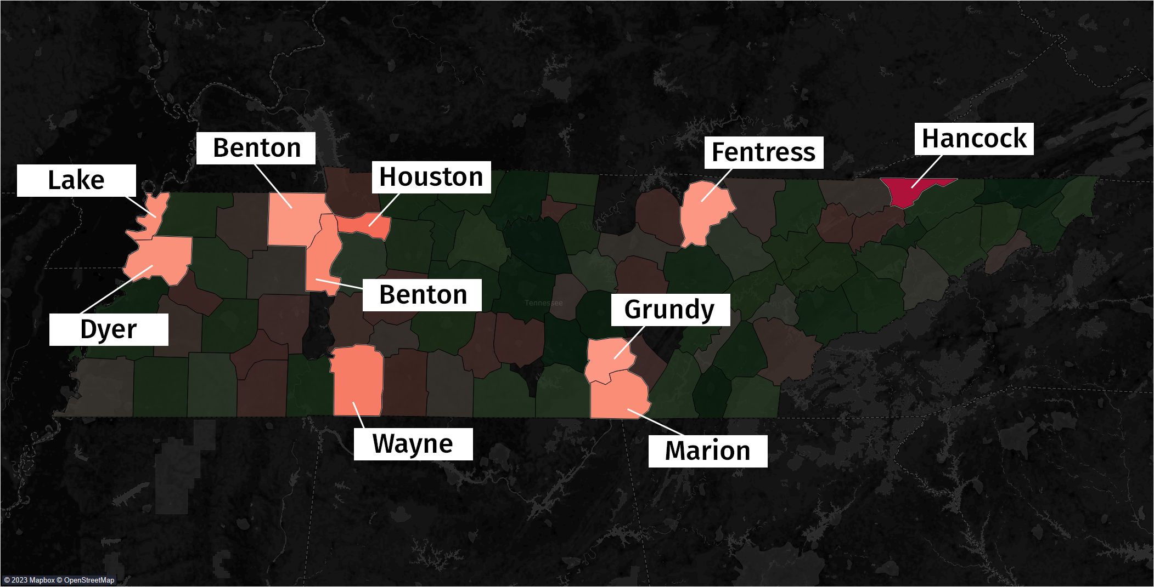
Notes:
Here are the top 10 counties in terms of highest EBLL. We’ve got Hancock, Houston, Wayne, Benton, Marion, Lake, Dyer, Henry, Grundy, and Fentress.

Slide 14
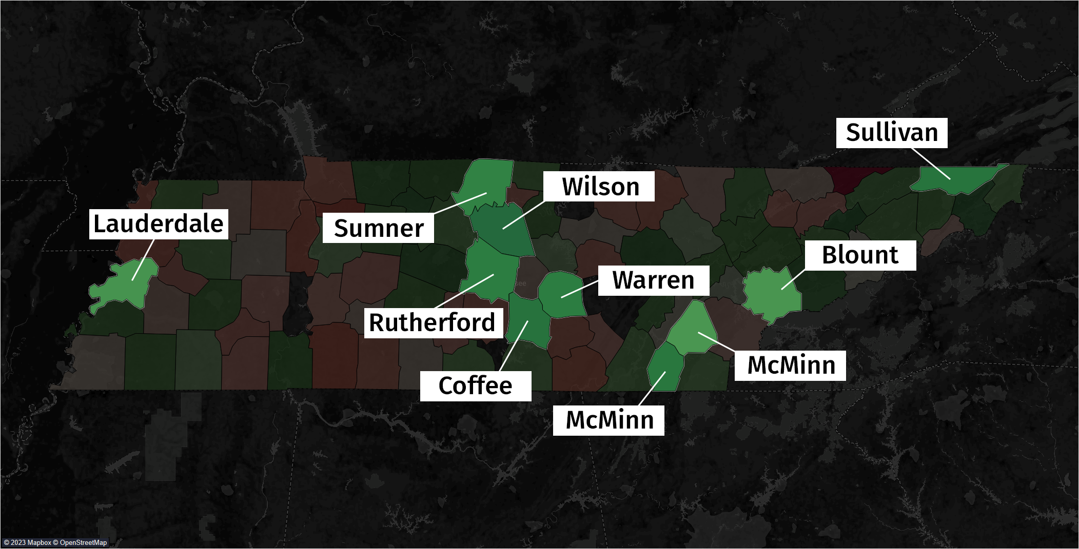
Notes:
And here are the top 10 in terms of lowest EBLL. That’s Wilson, Coffee, Sullivan, Bradley, Rutherford, Warren, Sumner, Lauderdale, Blount, and McMinn.

Slide 15
High EBLL
Low EBLL
Average Median Income | $22,209 | $28,447
Average Population | 18,390 | 126,576
Average Poverty Rate | 19.8% | 13.7%
Notes:
Here’s how both groups compare at a glance. And these numbers are all averages. So as you can see, counties with higher blood lead levels tend to be less populous and have lower incomes. The difference in the poverty rate here is pretty striking. 1 in 5 people in high EBLL counties live below the poverty line, and in Hancock County it’s 1 in 3. Meanwhile, the low EBLL counties are pretty much on par with the average poverty rate and median income for Tennessee as a whole. Now, let’s see how they compare in other ways.

Slide 16
Average EBLL per 1,000 Children
6.9
Notes:
First let’s check out the average EBLL in both groups. Children in the high counties are 6 times more likely to have an elevated lead level than those in the low counties. That’s huge! [CLICK] But here’s the average for all of Tennessee and it’s way lower. So what are the consequences?
To find out, I examined a number of quality-of-life metrics and these came from the US Census Bureau’s American Community Survey. We’re all familiar with the bureau’s regular 10 year censuses, but the American Community Survey is a persistent and ongoing collection of data that’s reported every year and it contains a truly overwhelming amount of information that can be drilled down to the county level. So definitely check that out if there’s any aspect about life in America that you’re curious about.

Slide 17
Infant Mortality per 1,000 Births
7.2
Notes:
First up is infant mortality. So here’s an area where Tennessee as a whole is in bad shape. We rank 11th in the nation for highest infant mortality rates. The low counties here are right at the national average, which is 5.4, [CLICK] and they’re even below the average for all of Tennessee, which is 7.2. Now, a difference of 2 deaths between the two groups may not seem like much, but to put it into perspective: if that 7.8 rate were true of all of Tennessee, it would amount to about 150 more infant deaths per year.

Slide 18
Disabilities in Children
6.4%
0.6%
Cognition
Hearing
Notes:
The rate of cognitive disabilities in children is really striking here. It’s nearly 10% for the high EBLL counties. And this includes a broad spectrum of disorders: ADHD, epilepsy, hydrocephaly, autism, dyslexia, just to name a few.
(CLICK)
And here are the rates for both for all of Tennessee. Hearing loss among children is right on par with the rest of the state, but it’s double the average in the high counties.

Slide 19
Premature Deaths per 100,000
493.4
Notes:
So this is the rate of premature deaths. The CDC defines any death that occurs before the age of 75 as being premature, and these figures are age-adjusted which means that more weight is given to deaths at a younger age than deaths that occur closer to 75. (CLICK) And here’s the rate for all of Tennessee.
The high county group is much higher than the average, but you can’t really blame this one entirely on lead, right? It’s just a fact that the poorer you are, the shorter your life is gonna be. And there’s a lot of reasons why this is the case, but the ones that we can actually influence on a policy level are how well these lower income communities are serviced and protected.
So is there a difference in the amount of effort we’ve put into the low and high counties? There’s a couple of metrics we can check to find out.

Slide 20
Housing Dangers
DPI
Pre 1979 Homes
Notes:
DPI here stands for “Deteriorated Paint Index,” which is a figure used by The Department of Housing to predict the percentage of occupied housing units with large areas of deteriorated paint, which is a strong predictor of the presence of lead dust.
And if you’ll recall, the use of lead paint was banned in 1978, so any home built before 1979 has a significant chance of containing lead painted surfaces.
And as you can see, roughly half of the homes in both groups were built before 1979. But there isn’t a huge disparity in either value between the two groups. Certainly not one big enough to explain why blood lead levels are 6 times higher in the high county group.
So if each group has roughly the same chance at ambient, everyday exposure to lead but one group is doing significantly worse than the other, you could conclude that the worse-of group is being neglected in some way. But there’s one more thing we can check, and with that it’s finally time to talk about Hancock County.

Slide 21
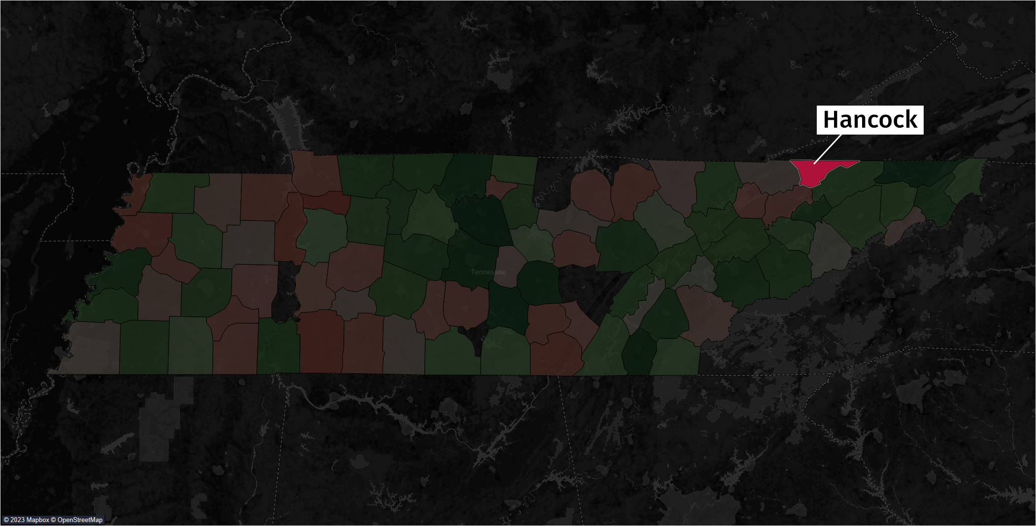
Notes:
So, Hancock County had the highest EBLL out of every county in the high group. Currently, it the lowest median income in all of Tennessee. But that wasn’t always the case.

Slide 22
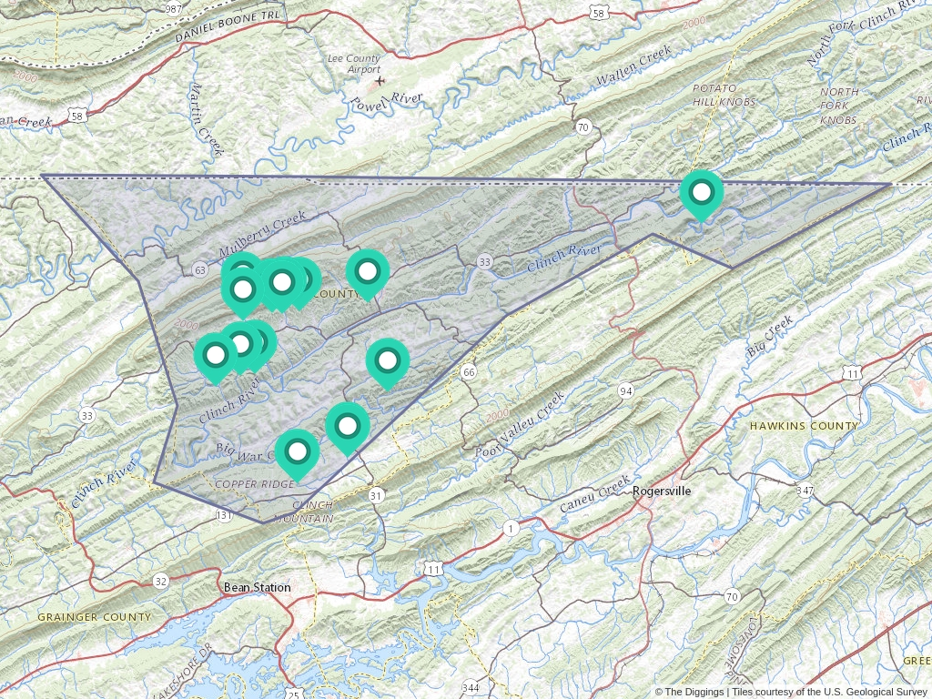
Notes:
Back in the 1950s, it was discovered that Hancock was rich with zinc deposits, and for the next 20 or so years Zinc became Hancock’s principal export. 14 mines sprung up all over the county, and when the Zinc dried up all of the mining companies simply abandoned bailed and left them abandoned.
Now, the thing about zinc metal is that it’s never been found naturally all by itself. The vast majority of zinc deposits contain a mineral called…lead sulfide. And if your operation is only interested in and set-up for extracting zinc, the leftover lead is simply discarded. And almost all of these mines are along the main aquifer in Hancock, the Clinch River.
So a big problem like this is beyond what a poor, rural community can solve themselves. A situation like that falls under the purview of the EPA’s Superfund program.

Slide 23
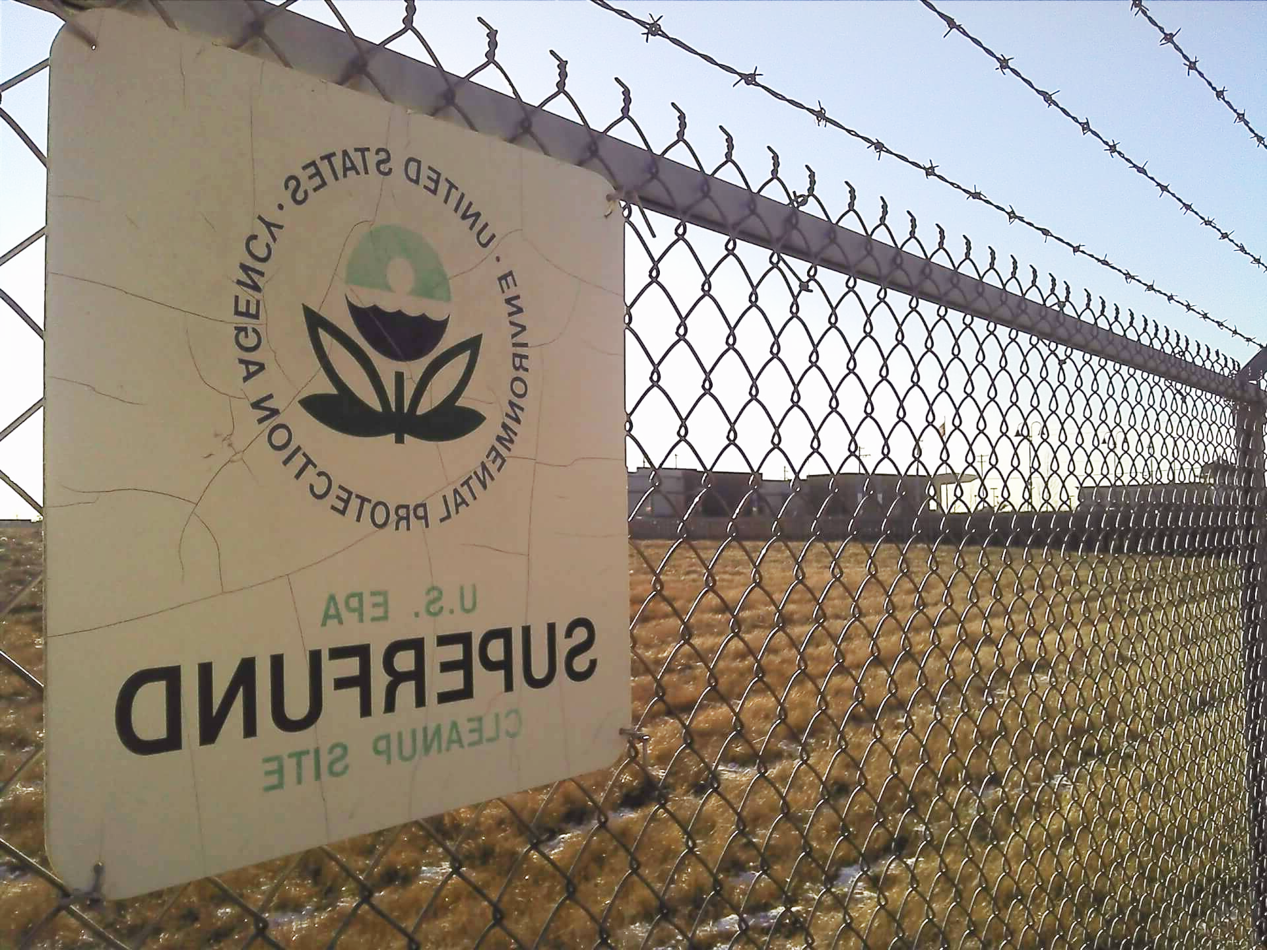

SUPERFUND SITES
The Superfund program grants the EPA the funds and authority to clean up contaminated sites when there’s no viable responsible party
Notes:
The Superfund program was started in 1980 to grant the EPA the funds and authority to clean up contaminated sites when there’s no viable responsible party. This could include abandoned factories, old industrial parks, processing plants, landfills, and of course mines. And we have all of this and more here in Tennessee. Let’s take a look at the map.
I actually live in one of these sites here in the East Lake neighborhood of Chattanooga and it’s specifically targeting lead in the soil. A number of houses on my block have had their property remediated, but mine was just above the threshold. Which is still worrying, of course.

Slide 24
Notes:
So here’s the EBLL map that we’re all familiar with by now.

Slide 25

Notes:
And here are all the currently active Superfund sites. We’ve still got some instances of high counties with Superfund sites over in west Tennessee, but from middle Tennessee and beyond you can clearly see the benefit of having an active environmental cleanup happening in your county. And nothing for Hancock county.

Slide 26
13
Superfund Sites
32
Superfund Sites
Notes:
Of the 54 total Superfund sites in Tennessee, over half of them are in the low counties. So there’s clearly a huge disparity in the services being provided for the low group over the high group.
Now, I’m sure there’s some grim math behind deciding where to establish a Superfund that certainly takes population and potential economic returns into account, but it’s kind of a self-fulfilling prophecy if that makes sense.
If a particular county is doing badly overall and seeing their population in decline, which is the case for almost every county in the high group, and you use that as a reason not to invest as many resources into them, then they’re just going to keep getting worse.
And you can’t just wait it out because the half-life for lead is about 700 years. Obviously a well-funded and supported federal program that’s free at the point-of-service would be ideal, but that’s kind of a hard sell here in the age of austerity and neoliberalism. Some other states have some ideas though.

Slide 27
Lead Abatment Tax Credits
Ohio
Massachusetts
Rhode Island
$10,000 max credit per taxpayer
$1,500 per housing unit
$1,500 per housing unit for mitigation, $5,000 or abatement
Notes:
Here’s a few states that offer some kind of tax incentive for homeowners to work on lead contamination on their property.
It’s not super great that we’re shifting the responsibility back onto individual citizens, but it is cool that they’ve made the credits available to owners of apartment buildings. So hopefully that results in renters also being protected.
And these funds can be used not just for lead paint and lead pipes, it can also be used for the removal of lead contaminated soil. Which is probably the best you can do without EPA intervention.
And Ohio actually offers a grant for units in certain high-risk counties, so we love that. But of course, a tax credit isn’t an option for Tennessee because we don’t have an income tax!
So if this is something you’re newly passionate about, then I highly recommend picking up some testing kits for your soil and tap water. Especially if you have kids in your home. You can get them on amazon or at the hardware store for about $30 a piece. And if you get a bad result, let your local departments of health and housing know. The process to establish a Superfund site can only be started by a municipal authority, so if you and your neighbors can bring them the data showing that you need help, the EPA might finally take notice.

Slide 28
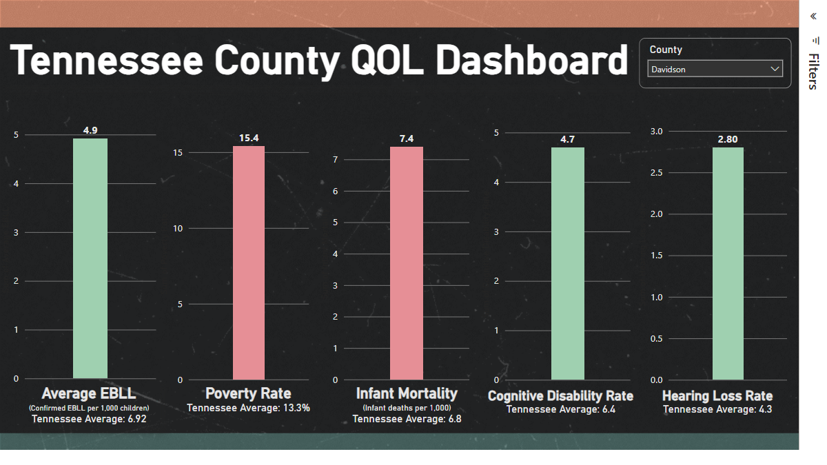
Notes:
And since I had all of that quality of data on hand, I went ahead and put together this quick dashboard so you can see at a glance how well a particular county is doing.
If a particular metric is above the Tennessee average, then the column turns red. Otherwise, green means you’re good to go.
I don’t want to take up too much of everyone’s time but if you’re interested in exploring the data, I’m happy to share the address after the presentation.

Slide 29
Thank you!
Robert Parker//da09
Notes:
And that’s all I got! Thanks for listening and if anybody has any questions, I’m happy to try to answer them.

